Slide 1
PROJECT PROPOSAL E-FOOD ORDER SYSTEM
NAZMUL AHASAN
ID:UG02-40-15-038
EMAIL:ahsansohel777@gmail.com

Slide 2
WELCOME
e-FOOD ORDER SYSTEM

Slide 3
Abstract
e-commerce refers to the purchase and sale of goods and/or services via Internet. e-Food Ordering System is a part of e-commerce. E-FOOD ORDER SYSTEM is a website designed primarily for use in the food delivery industry. Through these services restaurants can sell and distribute their resources at minimal resource usage effectively with high profits by gaining the customer trust. This Online food order system database will be helpful for the business owners to extend their business just by placing the orders online and not visiting the restaurant.

Slide 4
Introduction
It is known globally that, in today’s market, it is extremely difficult to start a new small-scale business and live-through the competition from the well-established and settled owners. In fast paced time of today, when everyone is squeezed for time, the majority of people are finicky when it comes to placing a food order. The customers of today are not only attracted because placing an order online is very convenient but also because they have visibility into the items offered, price and extremely simplified navigation for the order.
Online ordering system that I am proposing here, greatly simplifies the ordering process for both the customer and the restaurant. System presents an interactive and up-to-date menu with all available options in an easy to use manner. Customer can choose one or more items to place an order which will land in the Cart. Customer can view all the order details in the cart before checking out. At the end, customer gets order confirmation details. Once the order is placed it is entered in the database and retrieved in pretty much real time. This allows Restaurant Employees to quickly go through the orders as they are received and process all orders efficiently and effectively with minimal delays and confusion

Slide 5
Objective
The main objective of the project is to learn and implement a real-time website for Online-Food Ordering System. The project, concentrates on taking orders, streamlining the orders to a specified restaurant and billing. This site will be a great solution for many start-up food business, they can just start initially with less funds by posting their menu online with this website.

Slide 6
Features
Providing single platform for customers’ orders and restaurants.
Online menu with multiple food varieties.
Easy access for the customers to place and receive orders.
Providing the payment gateway for the restaurant
Check the review of the restaurant before ordering.
Notifying the customer with actual order time and expected delivery time.
Restaurant can Track the employee details.

Slide 7
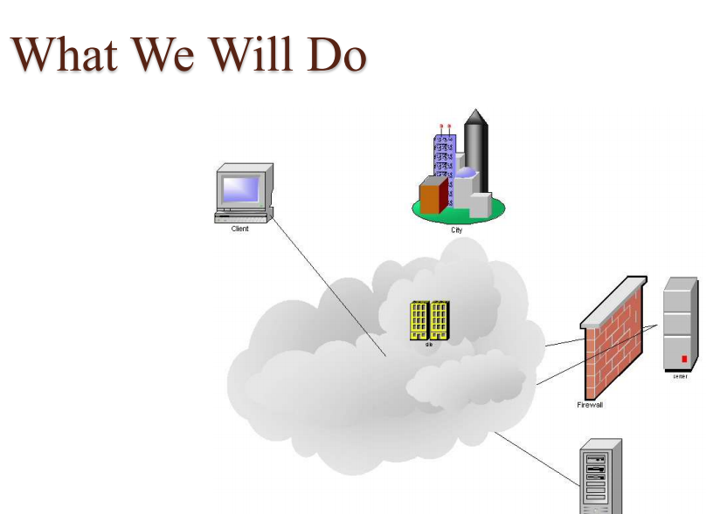

Slide 8
System and software requirements
Hardware/Software Interface:
•This section lists the minimum hardware and software requirements needed to run the system efficiently.
Hardware Interface:
• Pentium Processor
• 60 MB of free hard-drive space
• 128 MB of RAM
Software Interface:
• Operating System: Windows (Vista/7 or above).

Slide 9
System Model
The structure of the system can be divided into three main logical components. The first component must provide some form of menu management, allowing the restaurant to control what can be ordered by customers. The second component is the web ordering system and provides the functionality for customers to place their order and supply all necessary details. The third and final logical component is the order retrieval system. Used by the restaurant to keep track of all orders which have been placed, this component takes care of retrieving and displaying order information, as well as updating orders which have already been processed.

Slide 10
The Web Ordering System
Users of the web ordering system, namely restaurant customers, must be provided the following functionality:
Create an account.
Manage their account.
Log in to the system.
Navigate the restaurant’s menu.
Select an item from the menu.
Customize options for a selected item.
Add an item to their current order.
Review their current order.
Remove an item/remove all items from their current order.
Provide delivery and payment details.
Place an order.
Receive confirmation in the form of an order number.

Slide 11
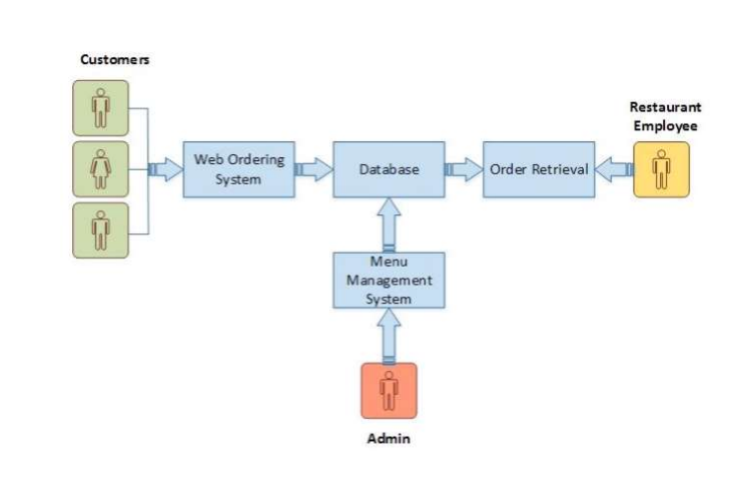
Program Requirements

Slide 12
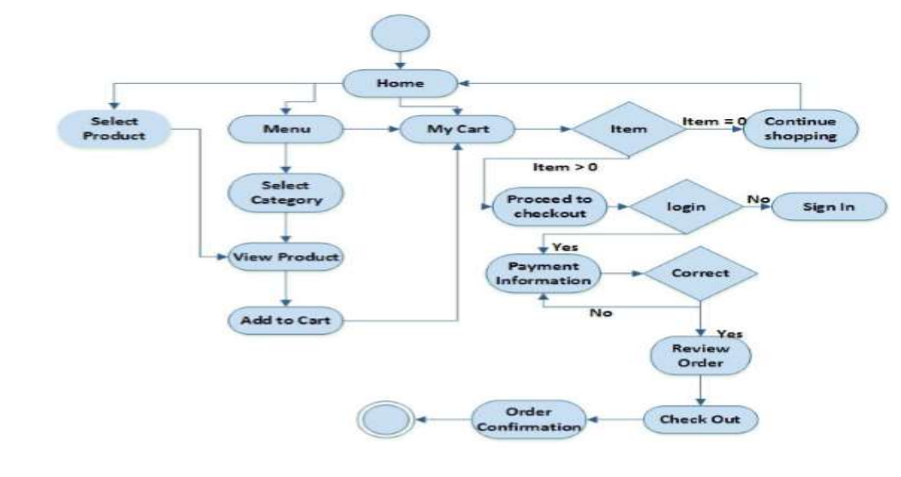
Activity Diagram

Slide 13
ACKNOWLEDGMENT
I would like to thank my honourable Khan Md. Hasib Sir for his time, generosity and critical insights into this project.

